Slide 1
Technological Modelling
Achievement Objective | Technological Knowledge – Technological Systems - Level 1 Understand that functional models are used to represent reality and test design concepts and that prototypes are used to test Technological outcomes
Learning Intention | I am learning... that technologists use technological modelling to help them with their design ideas and products.
Activity Instructions | Class discussion; What is a model/modelling? What is technological modelling? 2. Look at a product – e.g. a torch... What did the technologist do to help them make this torch? e.g. drawings, model, test materials, circuit diagram, prototype This is called technological modelling. 3. Go through each of the images of the different forms of modelling (below) Each group has a product/image of a product Which forms of modelling might have been used? What would it have told them? 4. Class discussion; What forms of technological modelling have you done for your outcome? (e.g. draft drawings, final drawing, pattern)

Slide 2
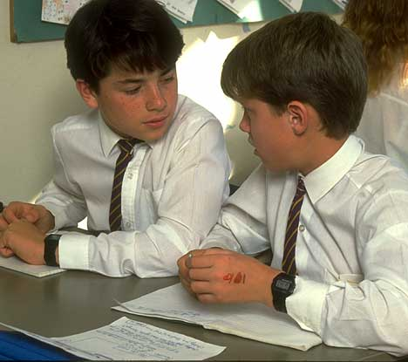
Thinking and talking about
your ideas.
Notes:
Functional modelling can include...
Thinking and talking
Drawings, diagrams
Patterns, templates
Tests and trials
Circuit diagrams/drawings
CAD, Google Sketch-up
3D models
Mock-up (which are models that are not the real size or the real materials)

Slide 3
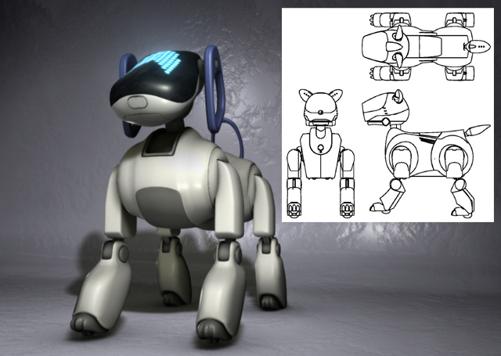
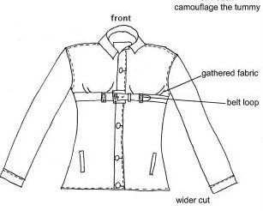
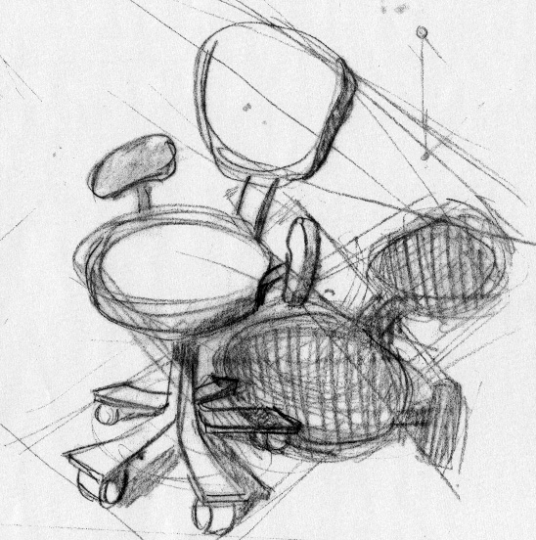
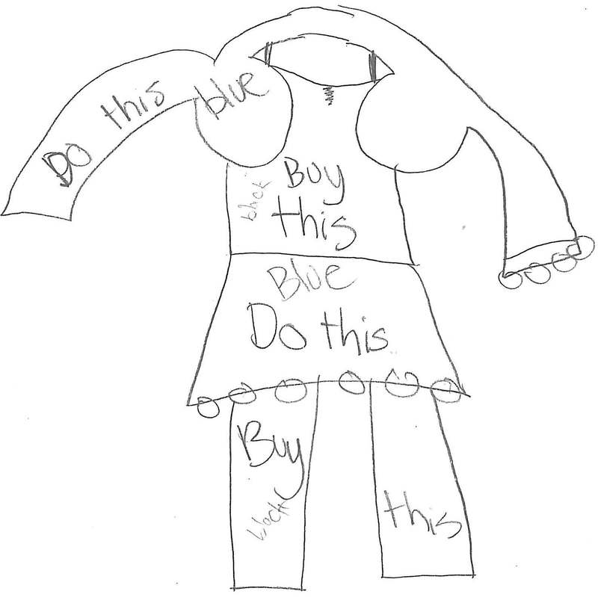
Drawing your ideas

Slide 4
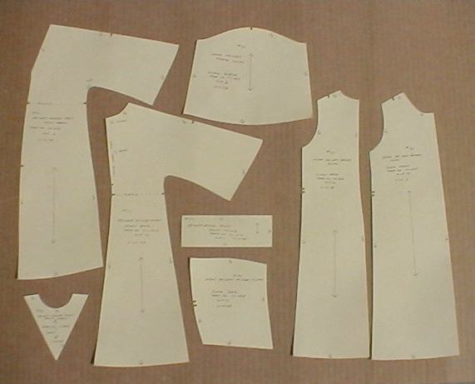
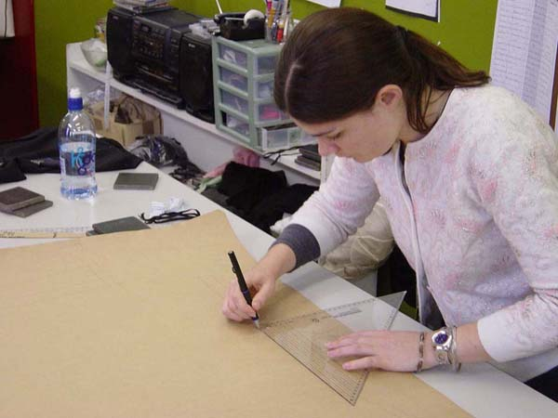
Patterns and templates

Slide 5
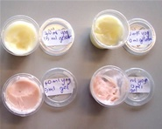
Tests and trials.

Slide 6
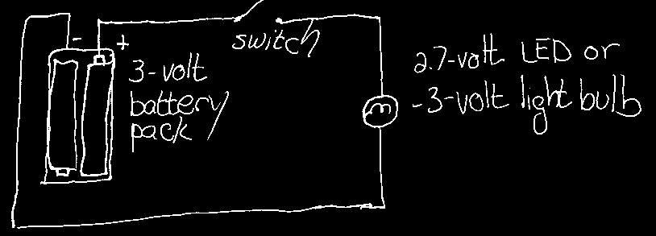
Circuit diagrams and drawings

Slide 7
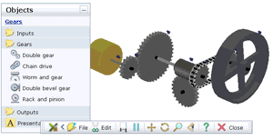
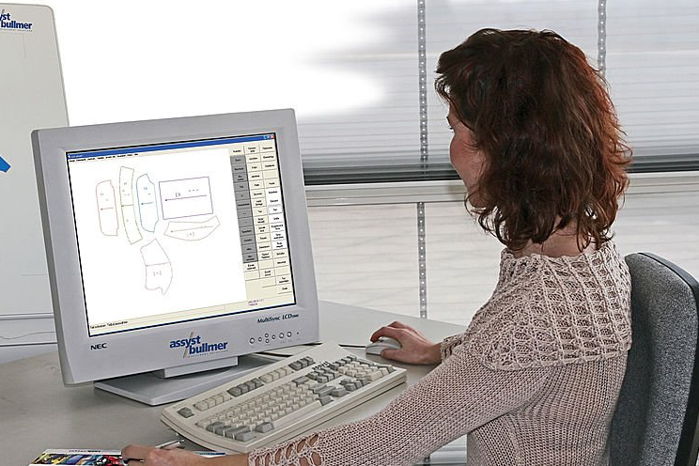
C.A.D (Computer Assisted Design)

Slide 8
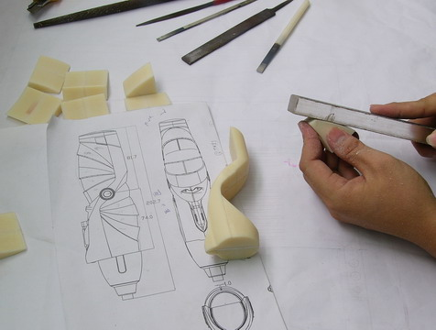
3D models and
mock-ups

Slide 9
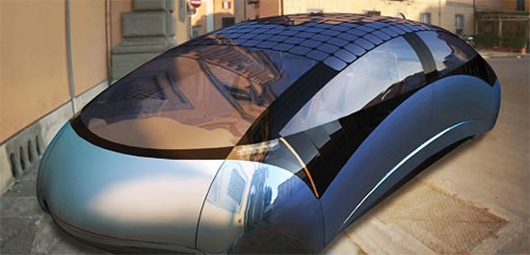
Prototypes
Notes:
Prototypes are usually...
The first, one-off version of the outcome, but not the first off the assembly line
It is a working model
It is made from the real materials
It is made full size (or maybe to scale)
It can be trialled in its real environment
Its purpose is to trial the outcomes fitness for purpose

